Slide 1
HOTEL MANAGEMENT SYSTEM

Slide 2
MEMBERS OF THE PROJECT
PRATHYUSHA
VYSHNAVY
SRI LEKHA
VARSHITHA

Slide 3
INTRODUCTION
PURPOSE:
This computerized hotel management system is used to tell the information of the rooms which are vacant easily since it is computerized and also can be able to bill the food eaten by the customer in the hotel
The whole bill of the customer is entered into the profile until the customer vacates the room

Slide 4
USER INTERFACE

Slide 5
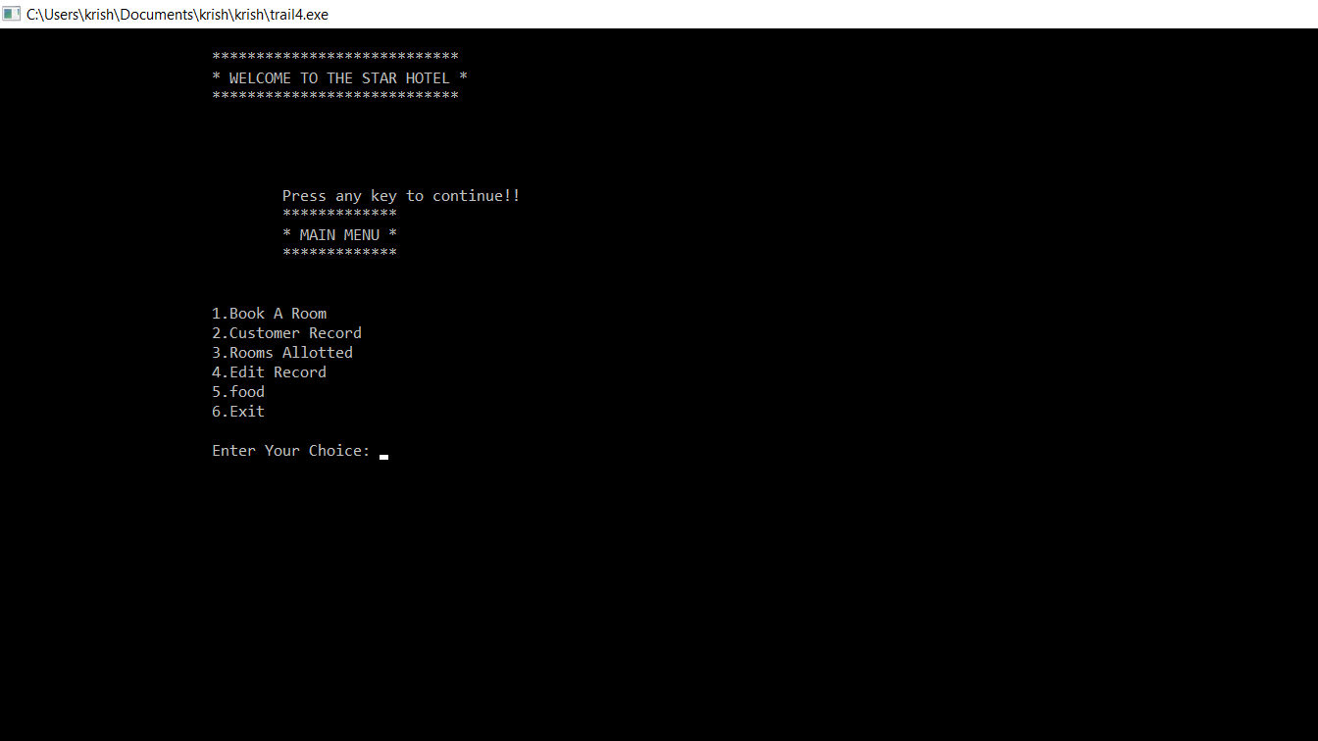
MAIN MENU

Slide 6
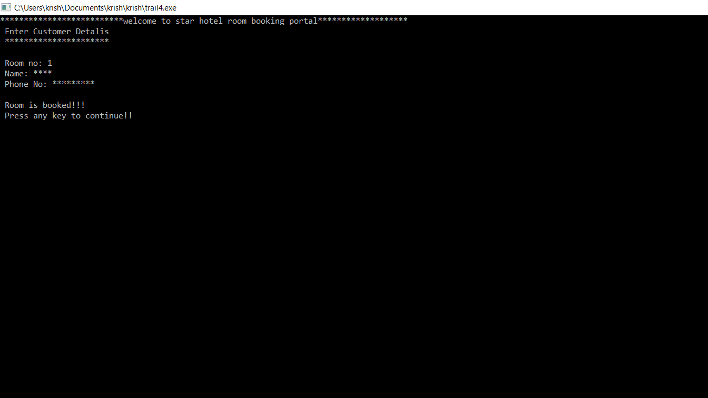
ROOM BOOKING PORTAL

Slide 7
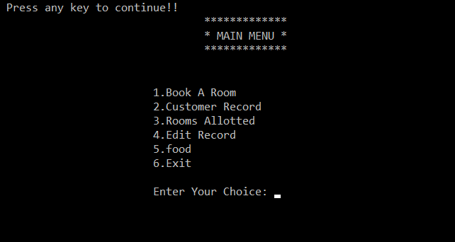
MENU

Slide 8
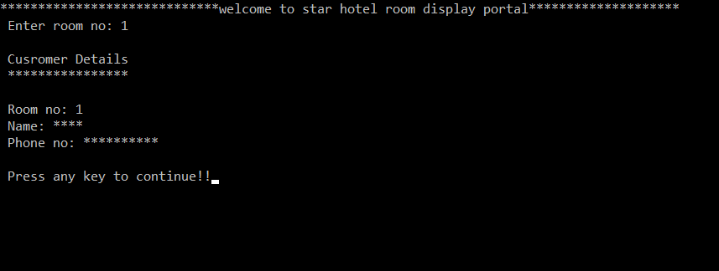
CUSTOMER RECORD

Slide 9
MENU

Slide 10
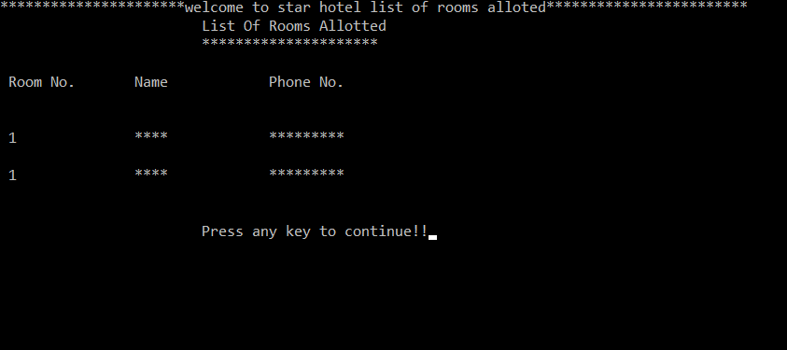
ROOMS ALLOTTED

Slide 11
MENU

Slide 12
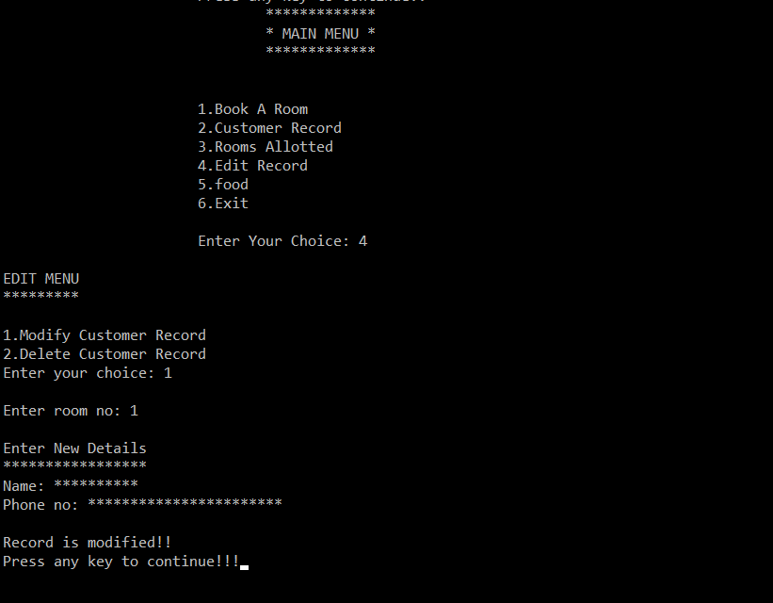
MODIFYING CUSTOMER RECORD IN EDIT RECORD

Slide 13
MENU

Slide 14
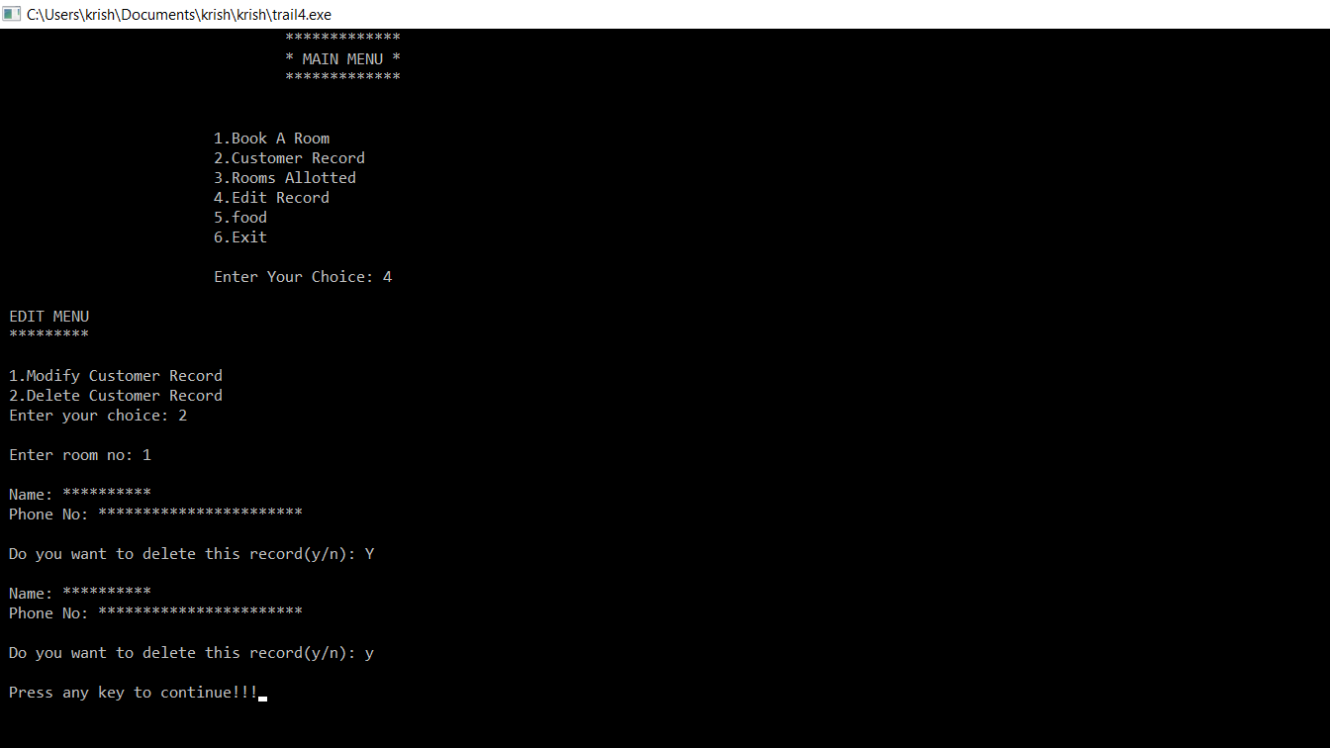
DELETING CUSTOMER RECORD IN EDIT RECORD

Slide 15
MENU

Slide 16
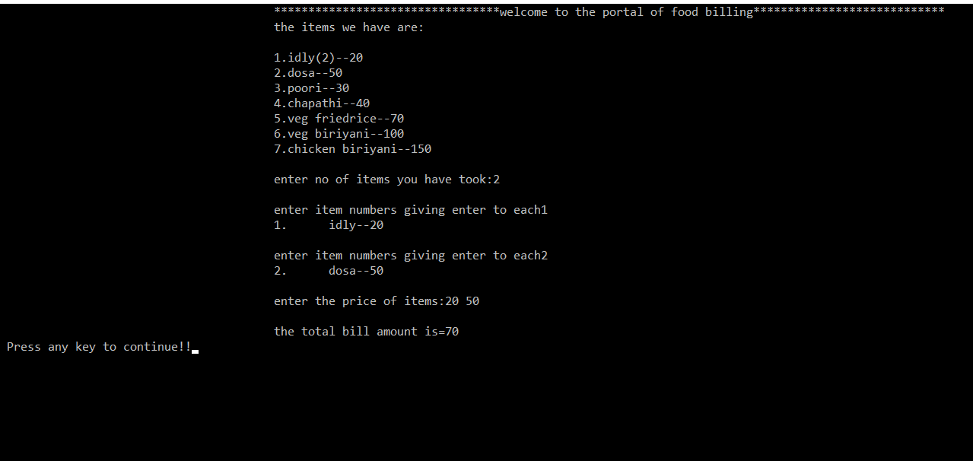
FOOD BILLING PORTAL

Slide 17
MENU

Slide 18
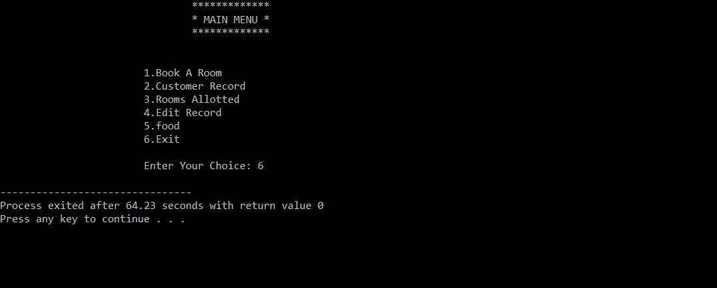
EXIT

Slide 19
THANK YOU

